Slide 1

Pipeline RISC-V Core with
Communication Extensions
and Advanced Arithmetic

Slide 2



RISC-V Core with Communication Extensions and Advanced Arithmetic
Supervised by :
Prof. Ahmed AbdAllah Hassan.
Eng. Abdullah Kamal.
Prof. Ahmed Saleh.
Team members :
Ahmed Magdy Fathy Mousa.
Ali Reda Ali Abdul Muttalib.
Hossam Ahmed Ali Seyam.

Slide 3


Agenda
01
Checkpoint Achieved
02
Single-cycle to pipelined execution.
03
Communication Extensions.
APB Protocol.
UART Protocol
GPIO
04
Advanced Arithmetic Operations
05
Conclusion and Future work.

Slide 4


02
01
Checkpoint Achieved

Slide 5
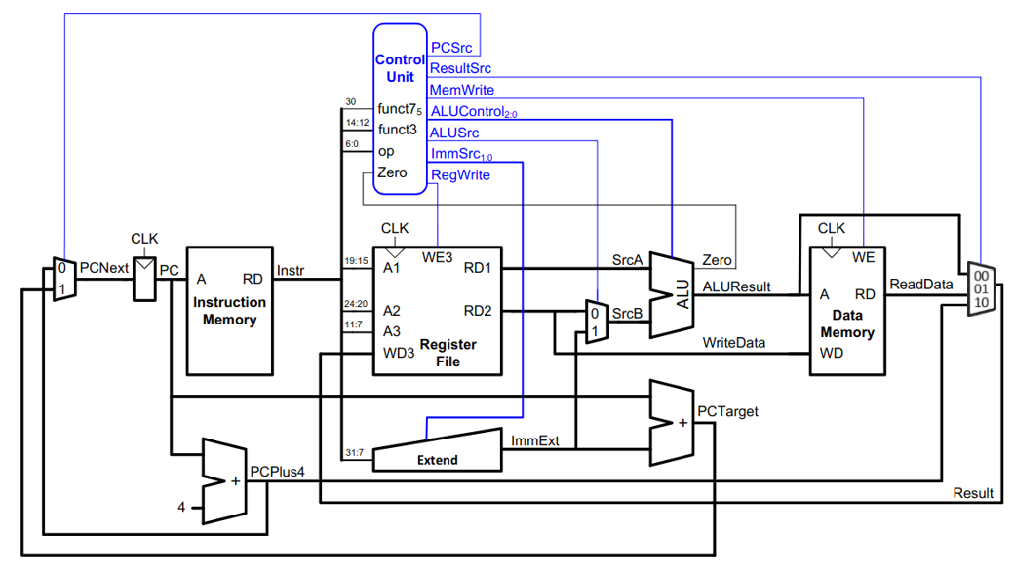
Checkpoint Achieved
RISC-V Singl Cycle architecture :

Slide 6
Checkpoint Achieved
RISC-V Singl Cycle architecture :

Slide 7
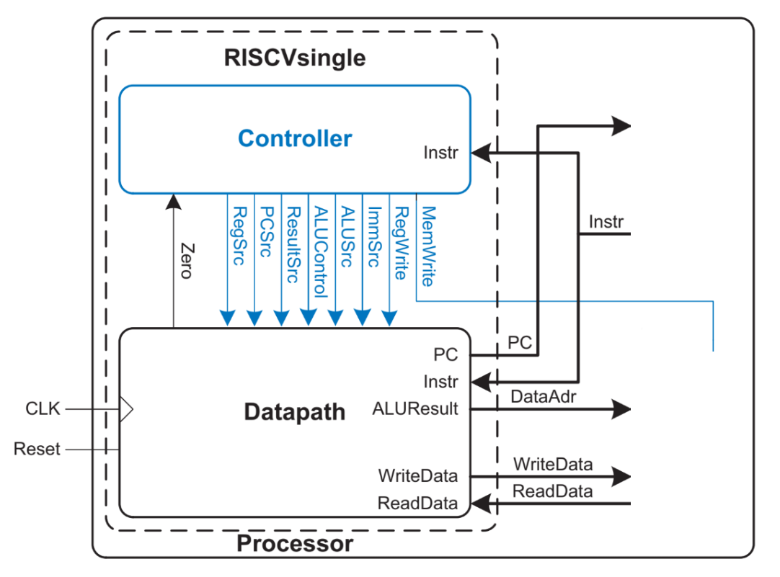
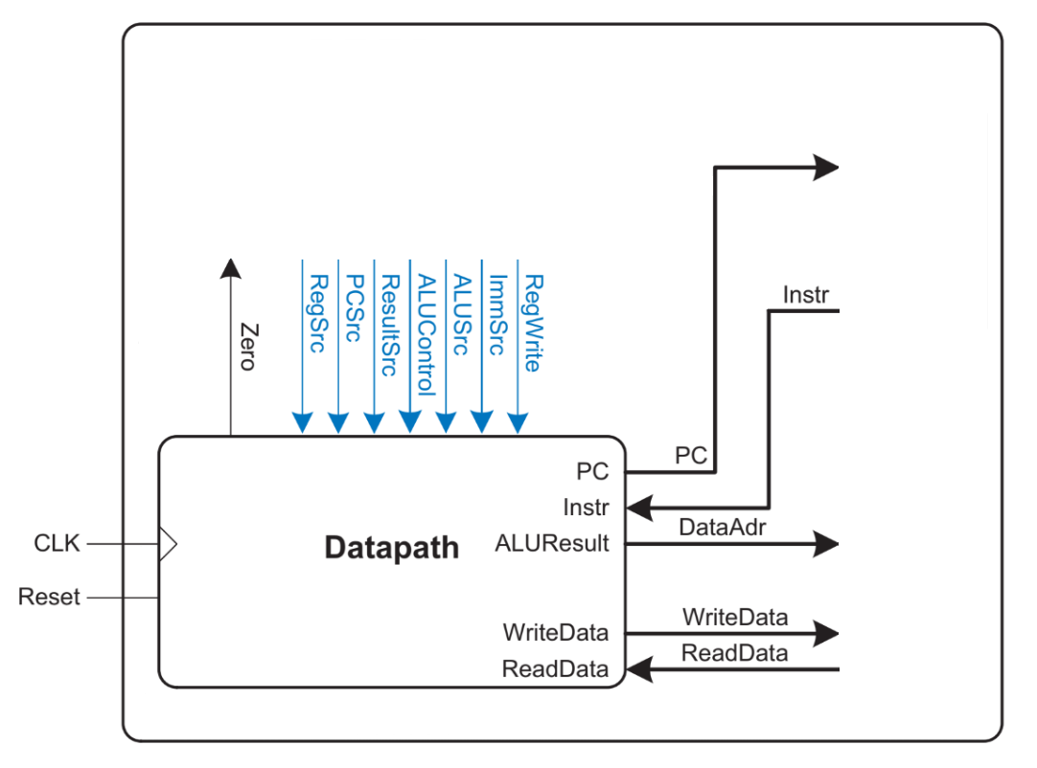
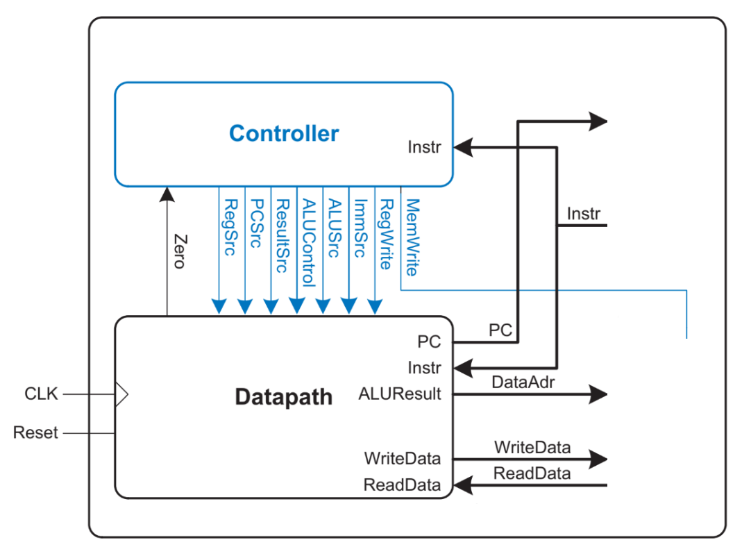
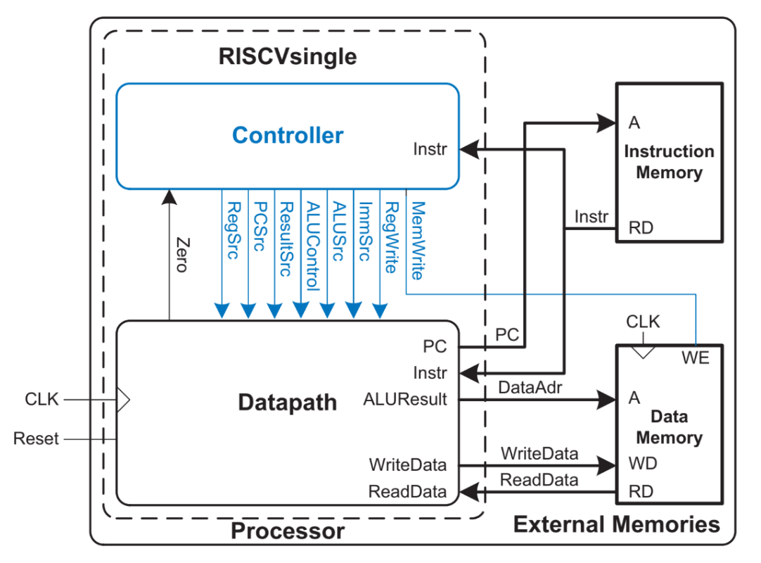
Checkpoint Achieved
RISC-V Integration :
The design Divided into Datapath, control unit and memory interface.

Slide 8
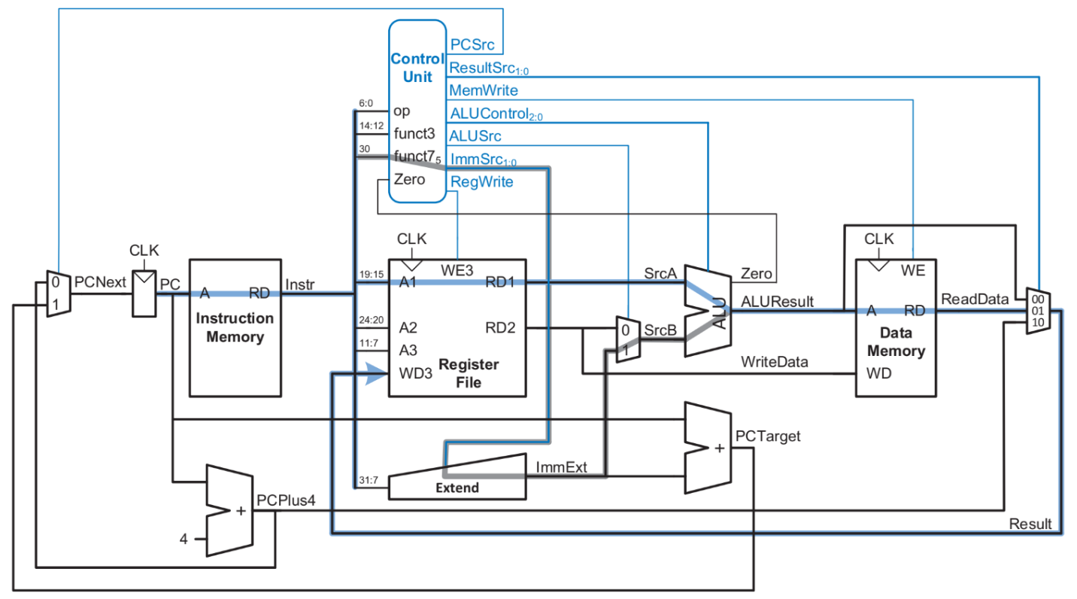
Checkpoint Achieved
Results :

Slide 9
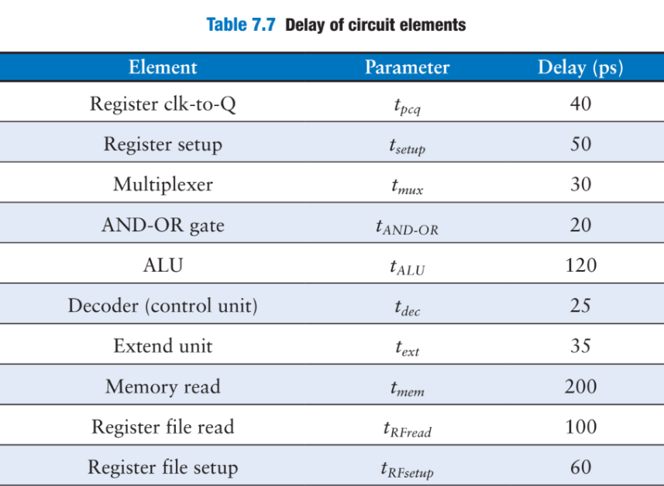
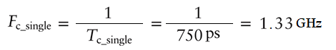
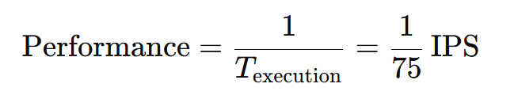
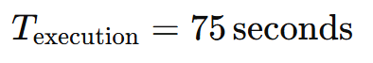
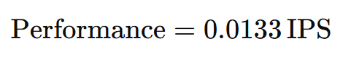
Checkpoint Achieved
Results :
The cycle time of the single-cycle processor is :
Processor frequancy will be :
100 billion instructions are used as a benchmark in computer architecture.

Slide 10


Checkpoint Achieved
Plan:
Phase 1 :
Foundation :
Foundation :
Studying the RISC-V architecture and its design concepts.
We explored the advanced arithmetic operations.
Design a comprehensive RISC-V single cycle processor.
Phase 2 :
Enhancements :
Implementing the pipelining.
Adding the advanced arithmetic operations.
Integrating the Communication protocol.

Slide 11

02
Pipelined

Slide 12
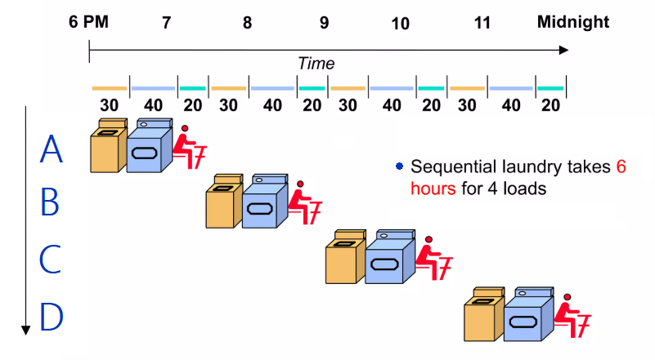
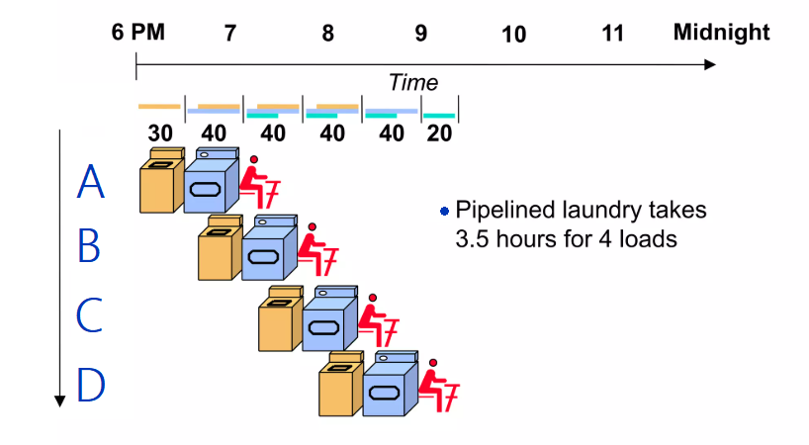
Pipelined
Characteristics of Pipelining :
Temporal parallelism.
Divide single-cycle processor into 5 stages:
– Fetch – Decode – Execute – Memory – Writeback
Add pipeline registers between stages.
Notes:
Motorola 68000 Family

Slide 13
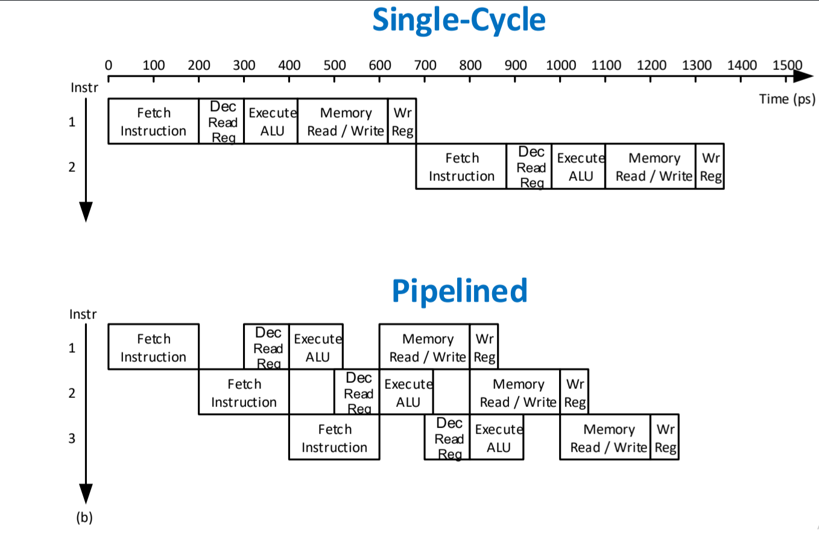
Pipelined
Characteristics of Pipelining :
The clock cycle is determined by the slowest stage, as all stages must operate in sync.
Notes:
Motorola 68000 Family

Slide 14
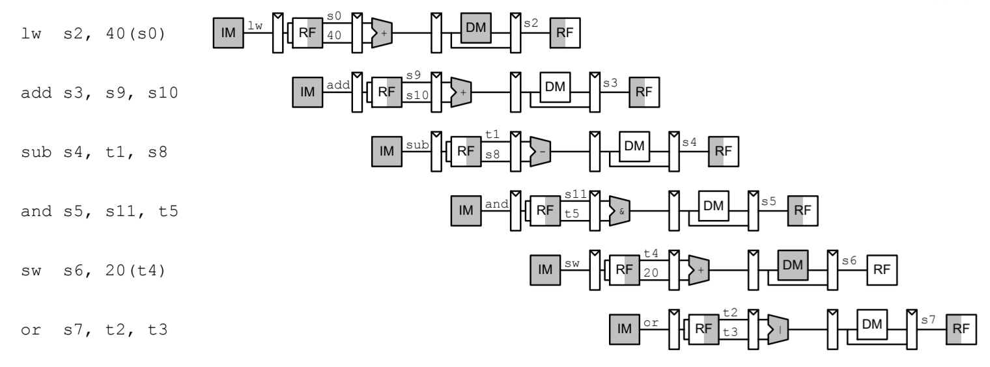
Pipelined
Characteristics of Pipelining :
Pipeline may have a longer clock, but overlapping instructions achieve better performance than single-cycle execution.
Notes:
Motorola 68000 Family

Slide 15
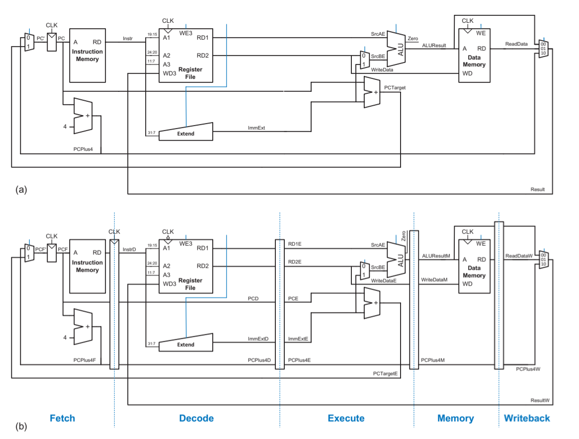
Pipelined
Single-cycle to pipelined execution :
Notes:
Motorola 68000 Family

Slide 16
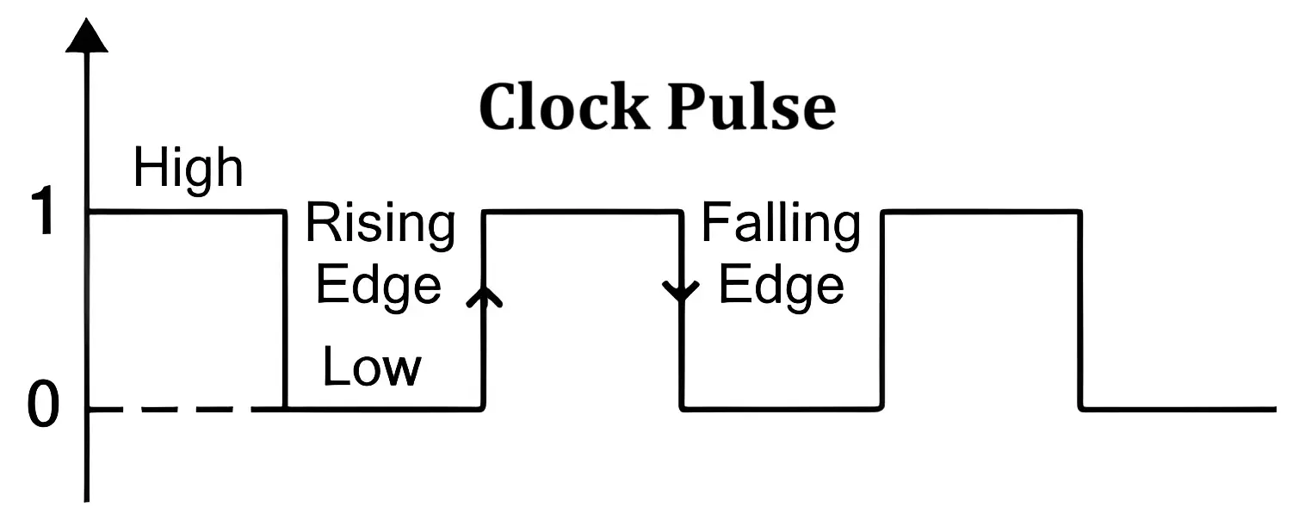
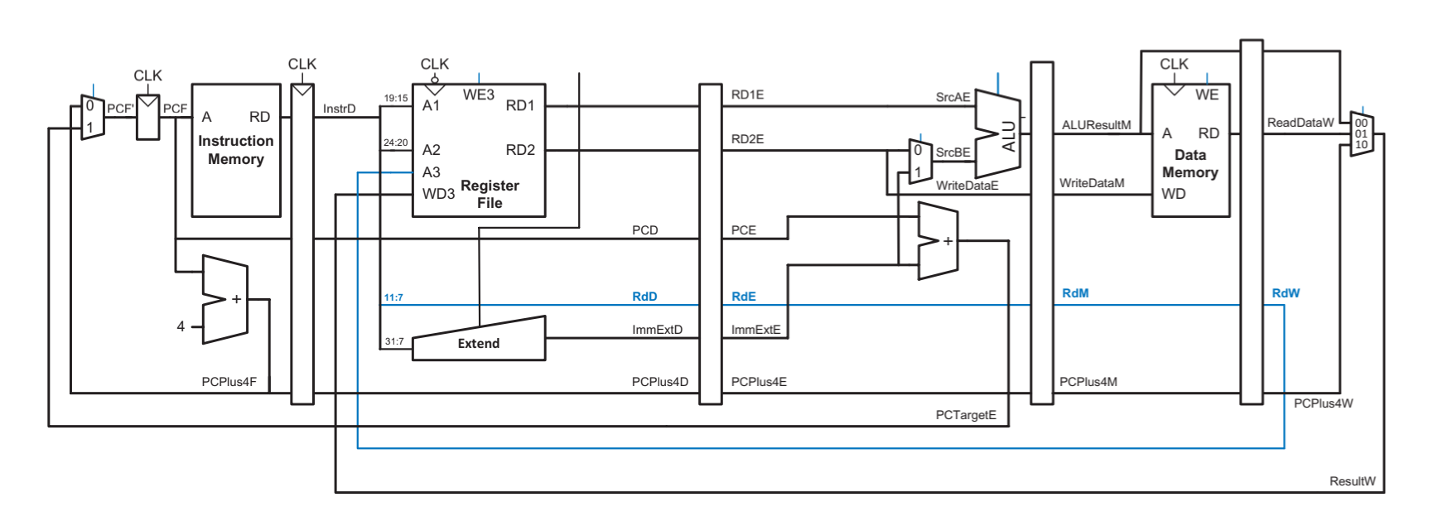
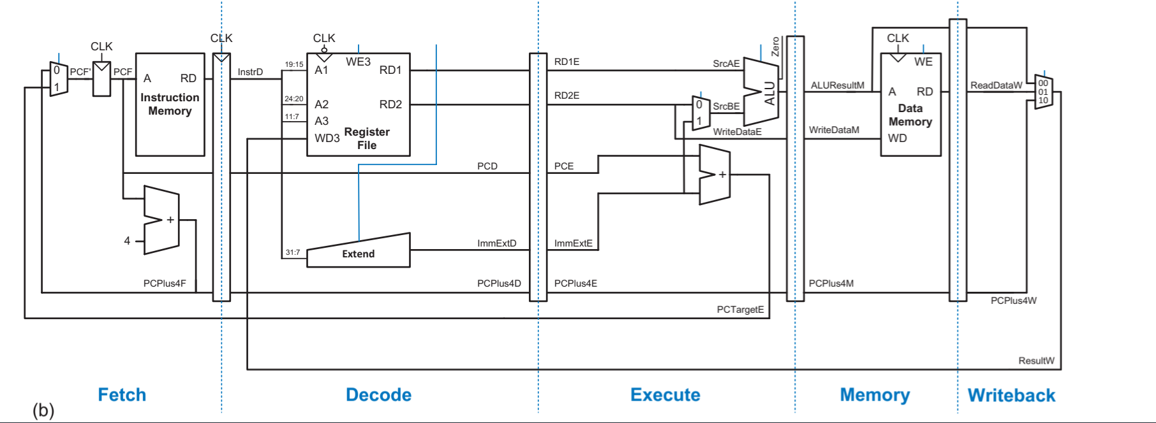
Pipelined
Single-cycle to pipelined execution :
Rd must arrive at same time as Result.
Register file written on falling edge of CLK.
Notes:
Motorola 68000 Family

Slide 17
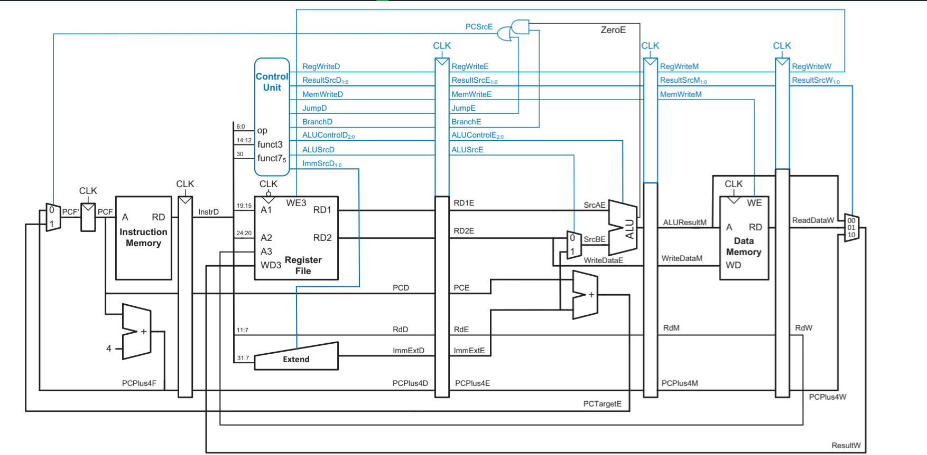
Pipelined
Single-cycle to pipelined execution :
Control unit as single-cycle processor travel with the instruction (drop off when used).
Notes:
Motorola 68000 Family

Slide 18
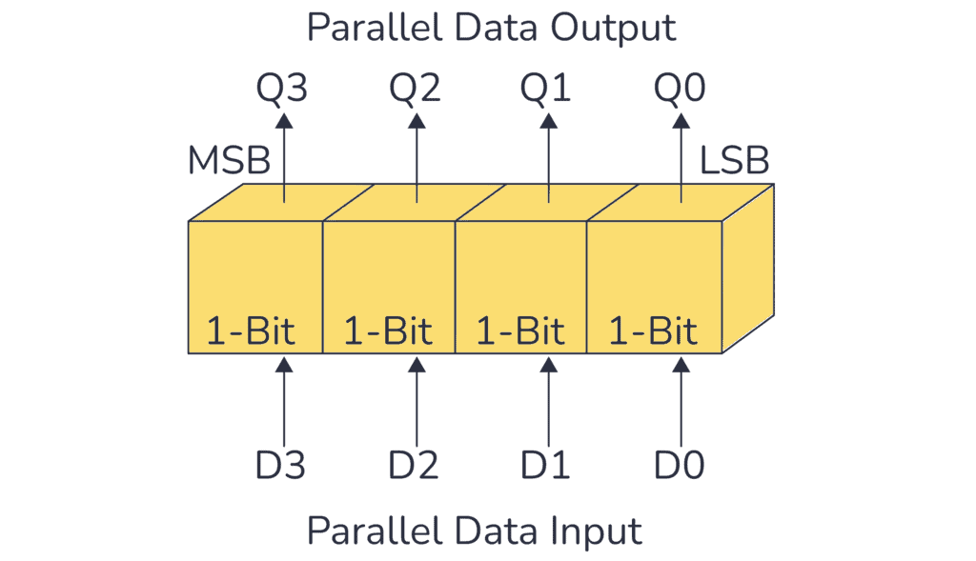
Pipelined
Registers :
There are 4 PIPO registers (FDR – DER – EMR – MWR).
FDR is 64 bits register.
DER is 160 bits register.
EMR is 90 bits register.
MWR is 40 bits register.
Notes:
Motorola 68000 Family

Slide 19
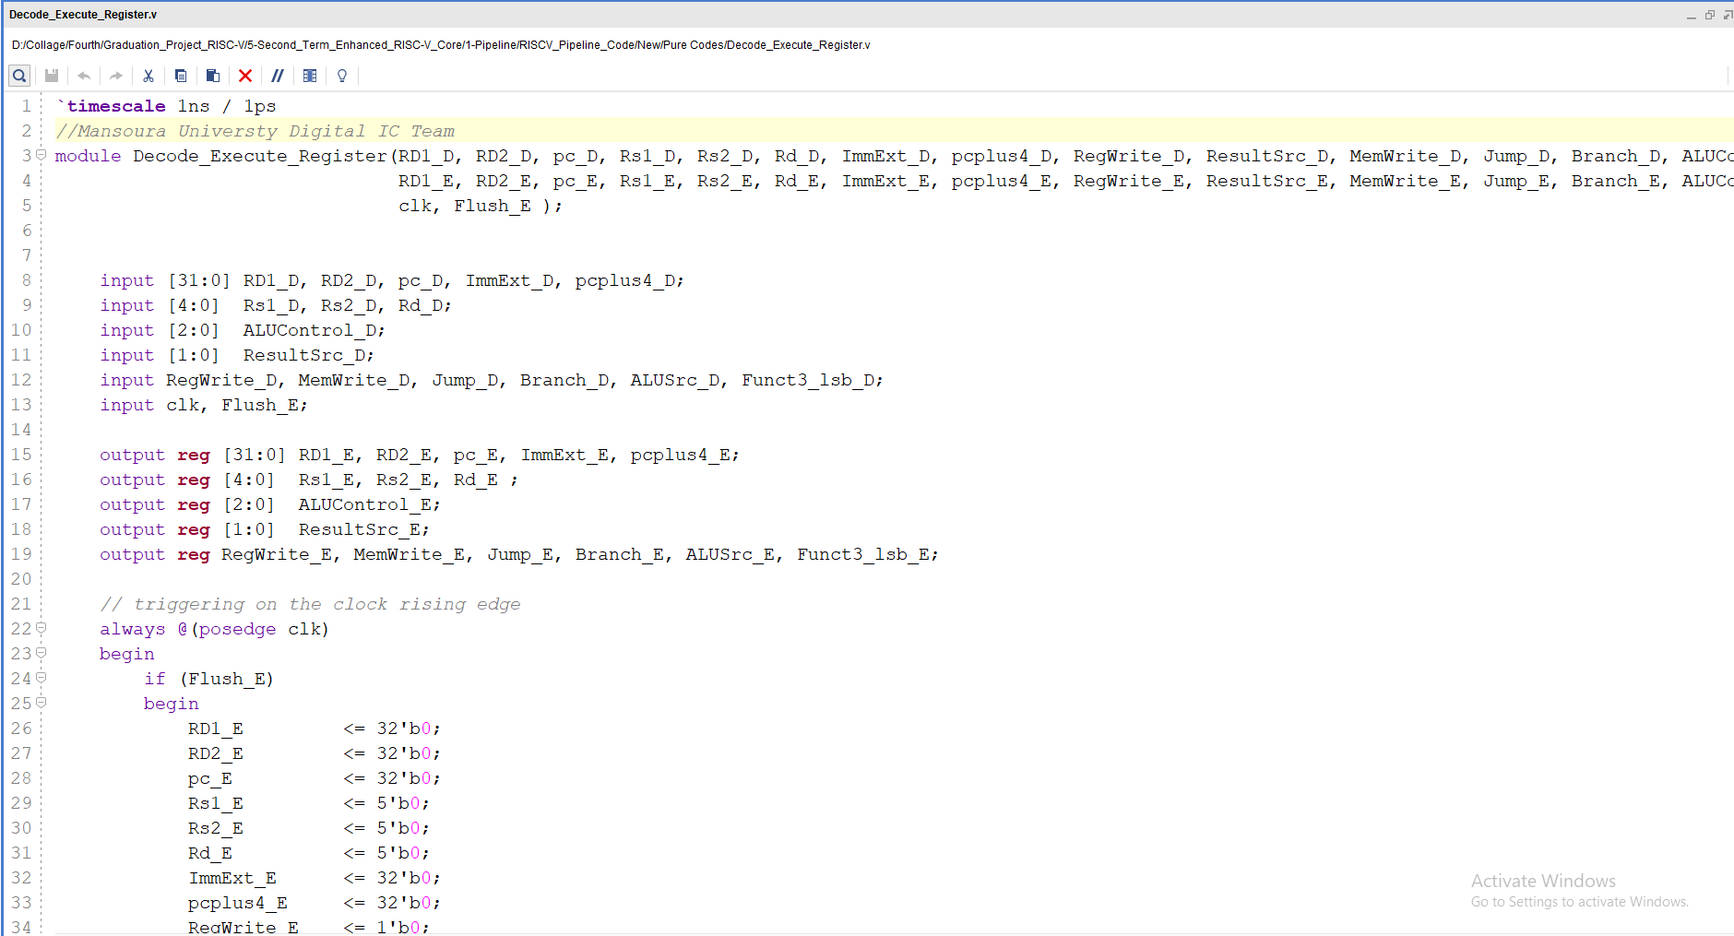
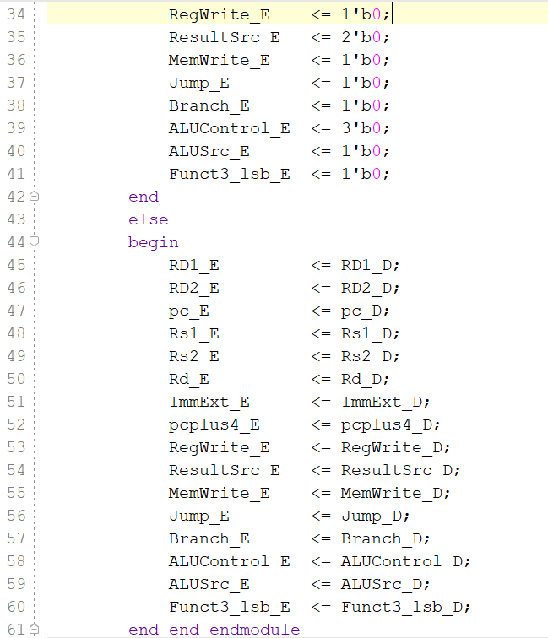
Pipelined
Register DER :
Notes:
Motorola 68000 Family

Slide 20
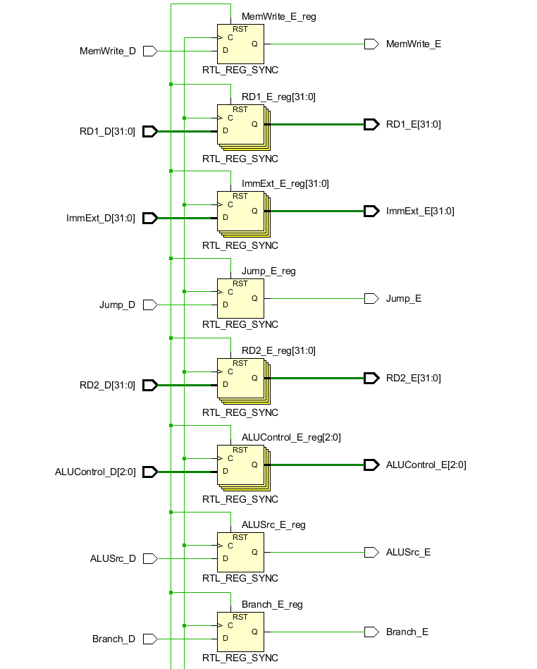
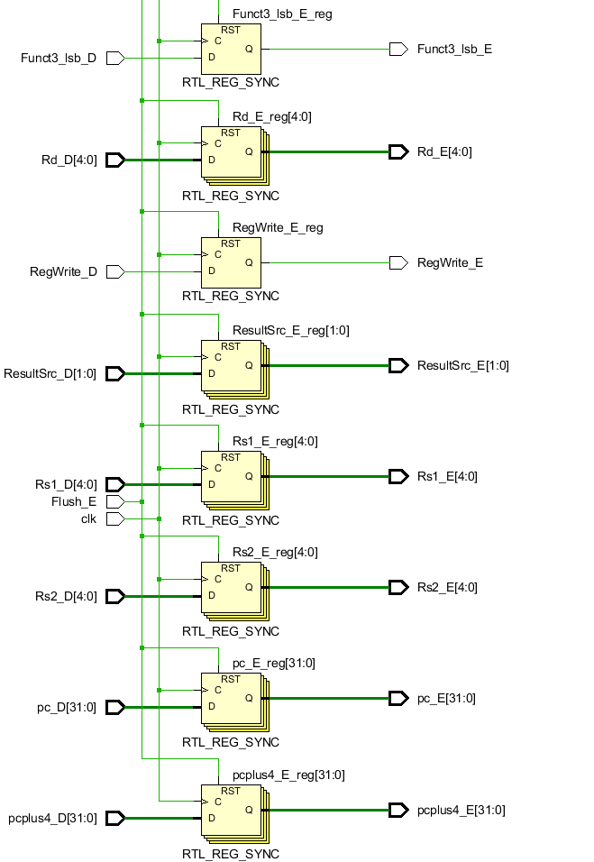
Pipelined
Register DER :
Notes:
Motorola 68000 Family

Slide 21
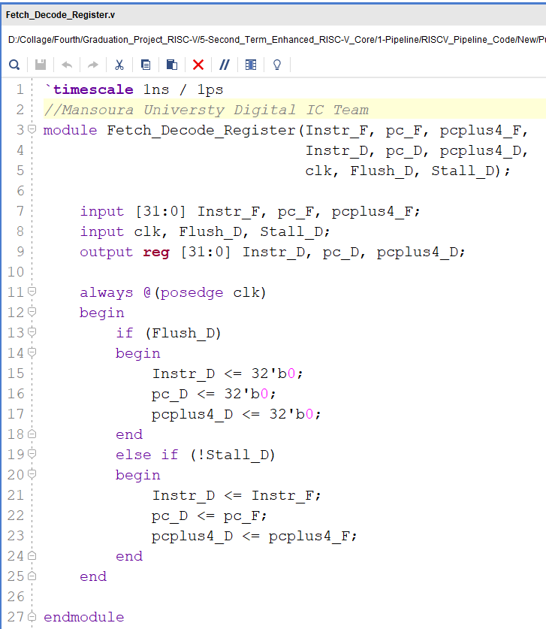
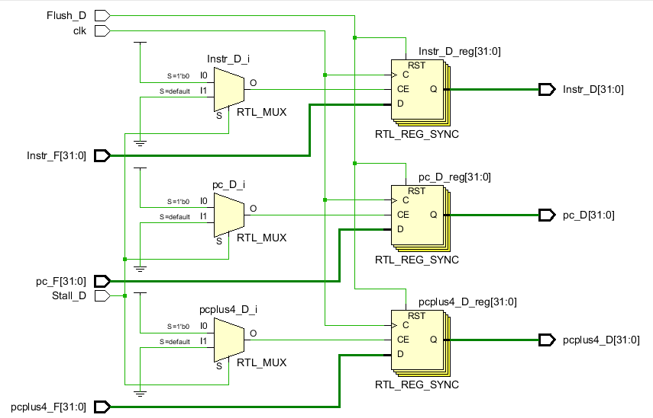
Pipelined
Register FDR :
Notes:
Motorola 68000 Family

Slide 22
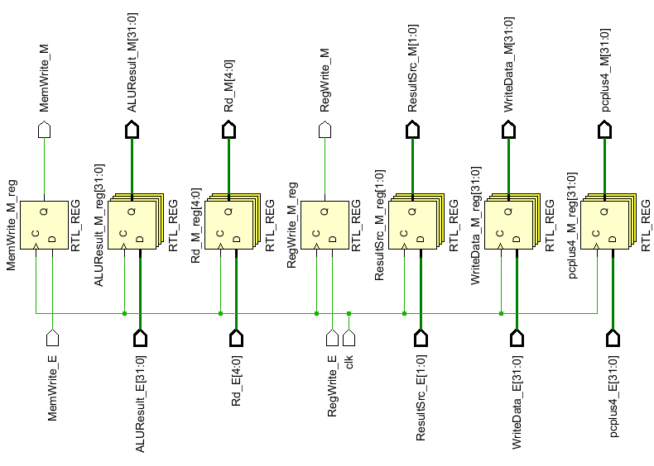
Pipelined
Register EMR:
Notes:
Motorola 68000 Family

Slide 23
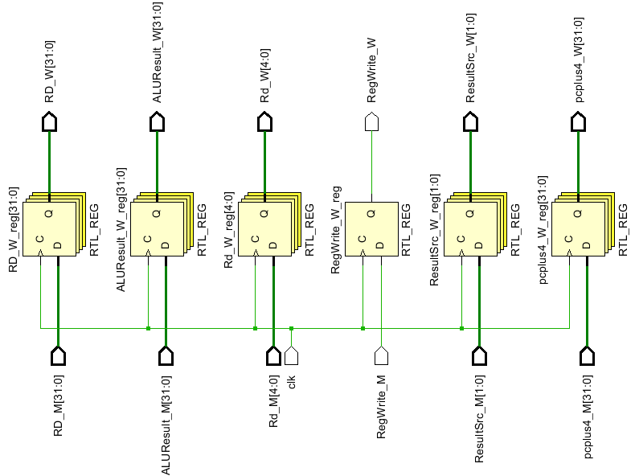
Pipelined
Register MWR:
Notes:
Motorola 68000 Family

Slide 24
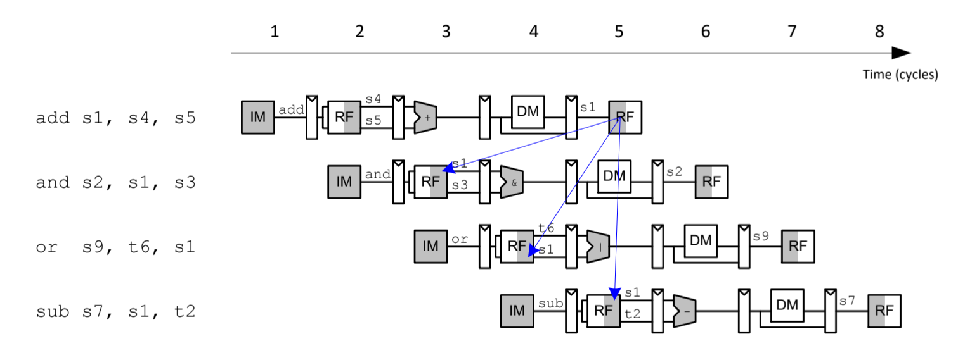
Pipelined
Pipeline Hazards :
Hazard happens when an instruction depends on result from instruction that hasn’t completed.
Types of Hazard are Data hazard & Control hazard.
Data hazard :
Register value not yet written back to register file.
Notes:
Motorola 68000 Family

Slide 25
Pipelined
Data Hazards :
How do we ensure that our programs run correctly ?
Insert nops in code at compile time .
Forward data at run time.
Stall the processor at run time.
Notes:
Motorola 68000 Family

Slide 26
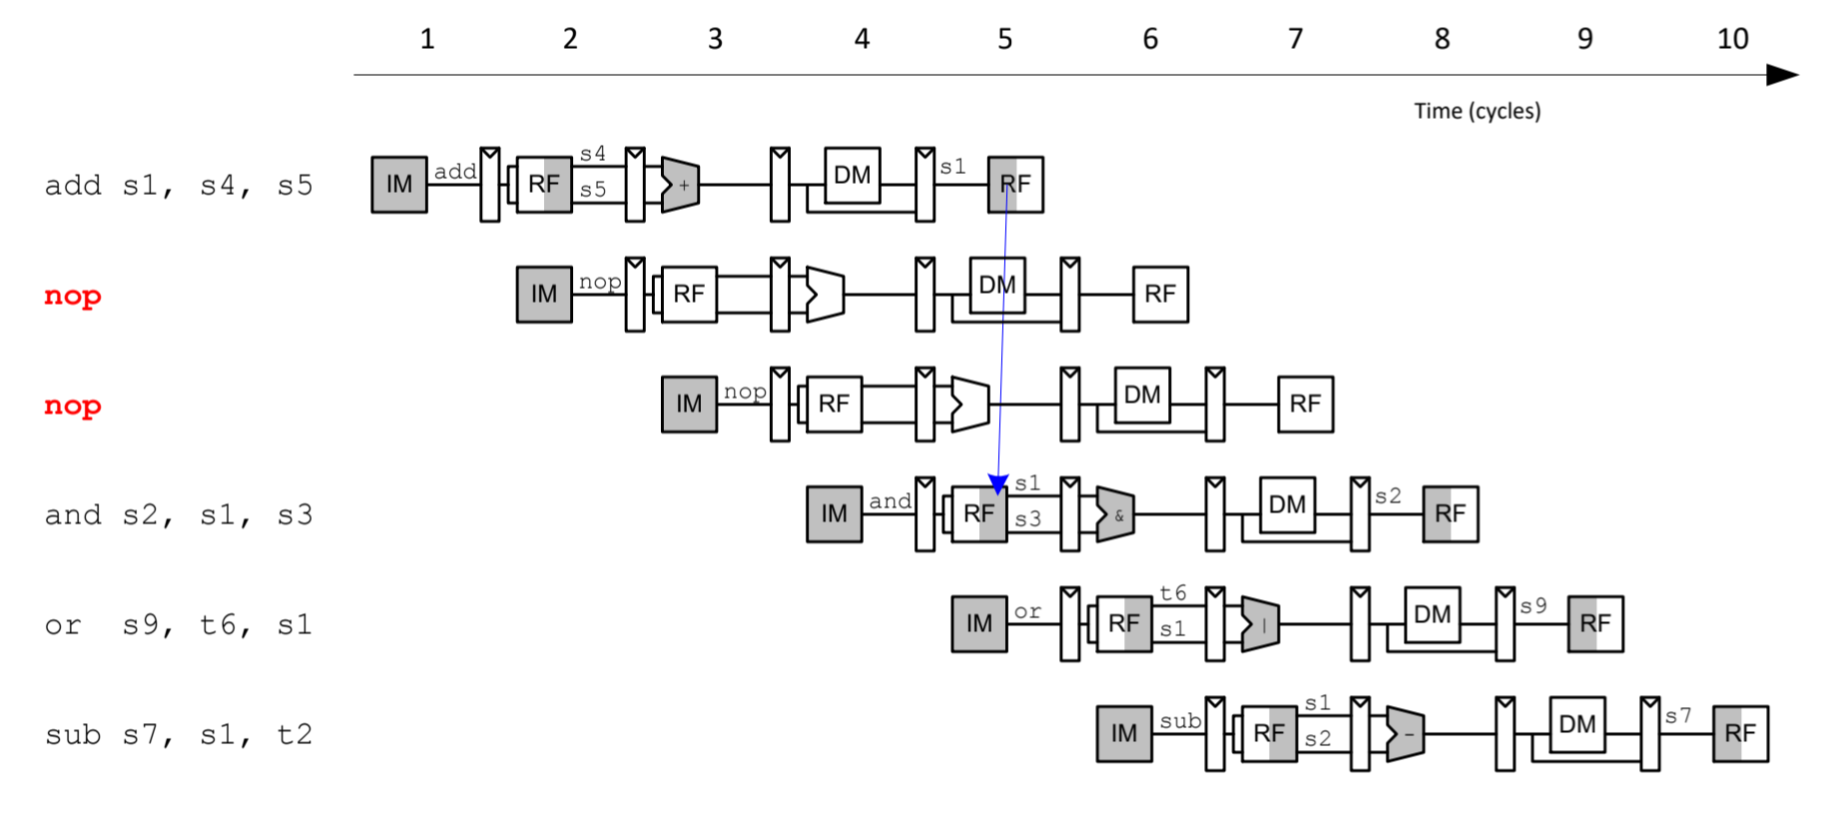
Pipelined
Data Hazards :
Insert enough nops for result to be ready.
Notes:
Motorola 68000 Family

Slide 27
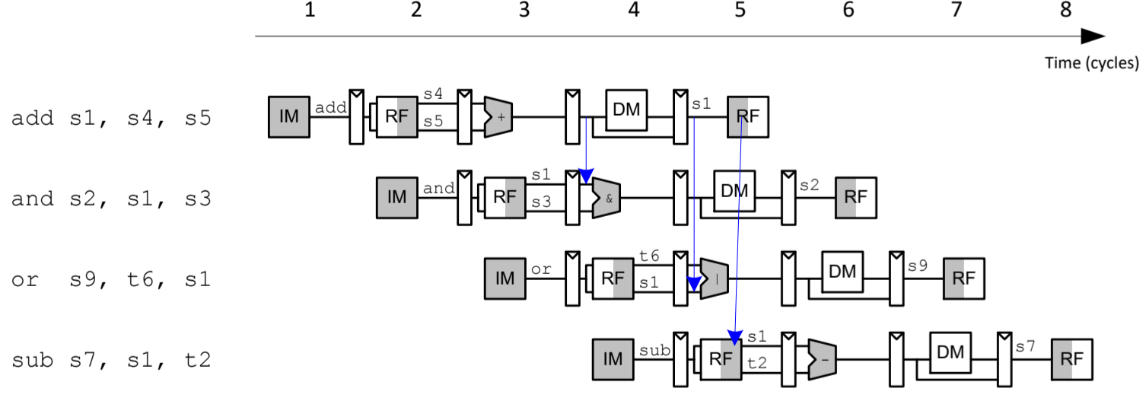
Pipelined
Data Hazards :
Forward data at run time.
Check if register read in Execute stage matches register written in Memory or Writeback stage If so, forward result
Notes:
Motorola 68000 Family

Slide 28
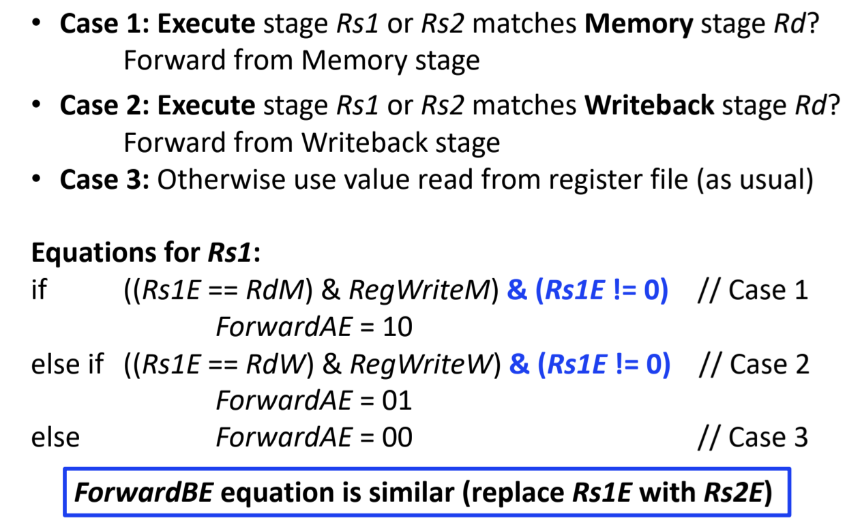
Pipelined
Data Hazards :
Forward Logic :
Notes:
Motorola 68000 Family

Slide 29
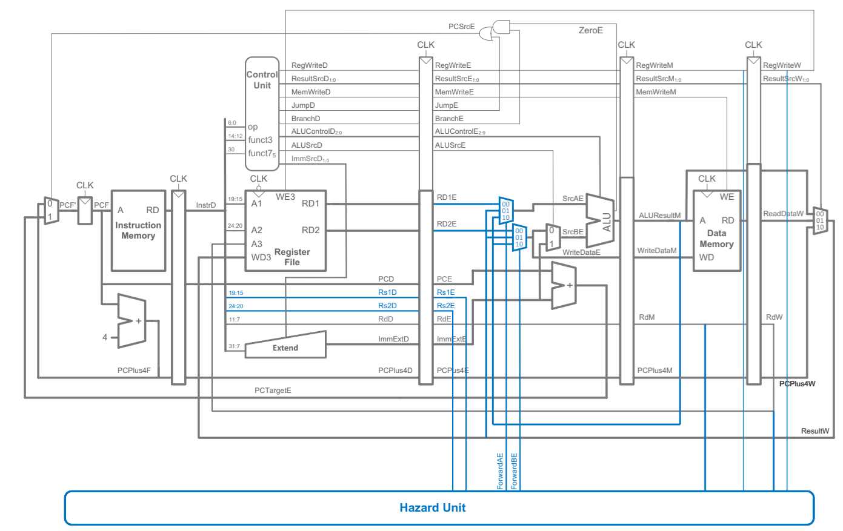
Pipelined
Data Hazards :
Notes:
Motorola 68000 Family

Slide 30
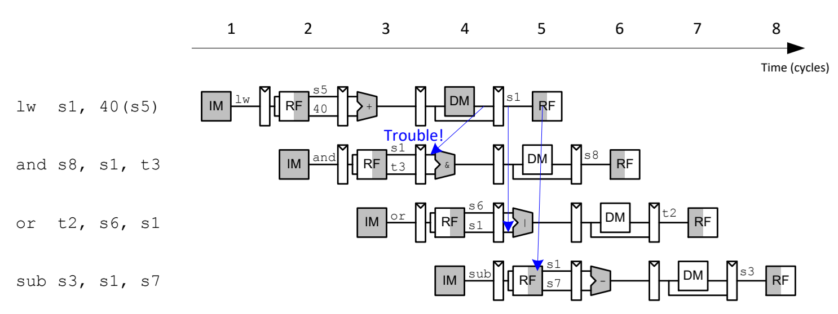
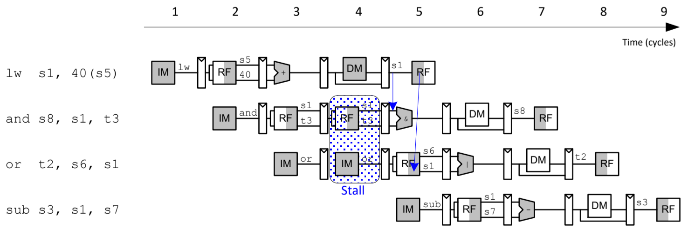
Pipelined
Data Hazards :
Stall the processor at run time.
Is a temporary pause in the pipeline waits for data or resources that are not yet ready.
Notes:
Motorola 68000 Family

Slide 31
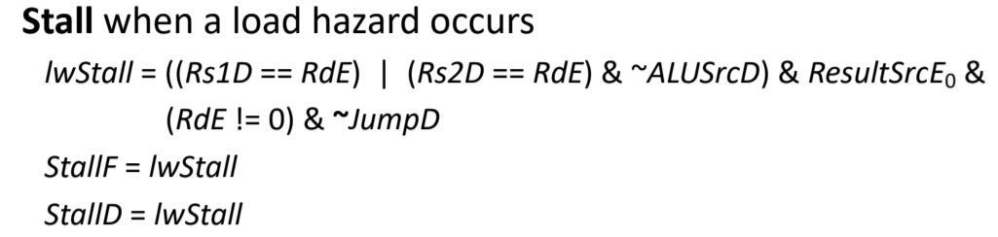
Pipelined
Data Hazards :
Stalling Logic :
Notes:
Motorola 68000 Family

Slide 32
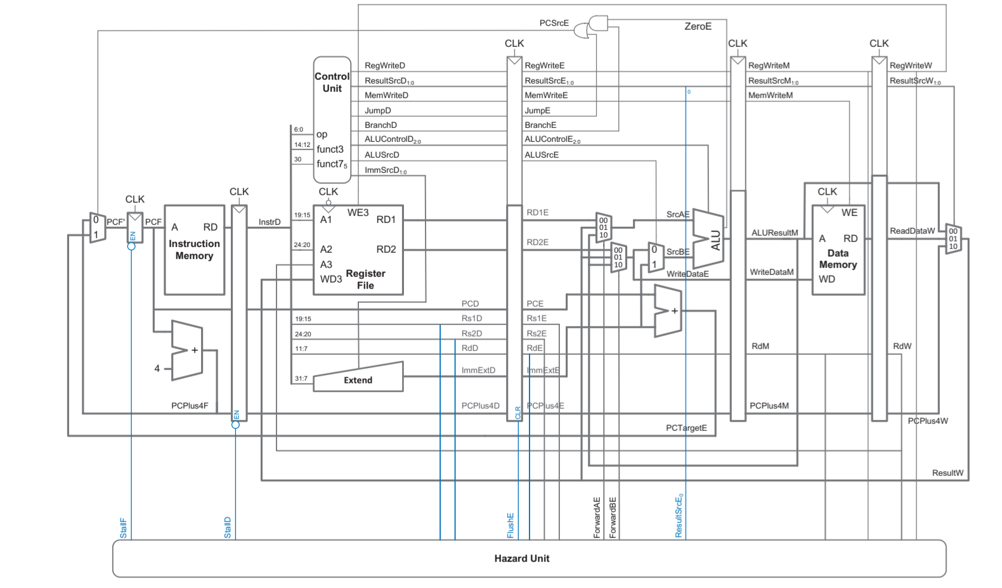
Pipelined
Data Hazards :
Notes:
Motorola 68000 Family

Slide 33
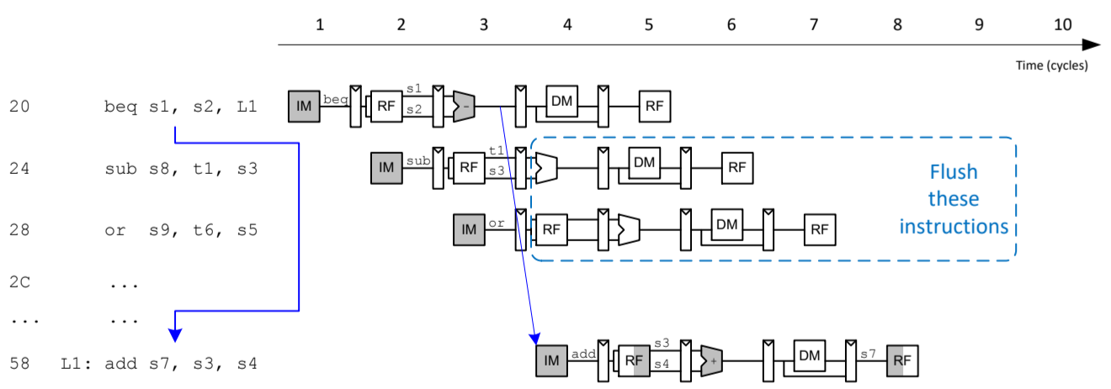
Pipelined
Control Hazards :
Next instruction not decided yet(caused by branch).
beq:
– branch not determined until the Execute stage of pipeline
– Instructions after branch fetched before branch occurs
– These 2 instructions must be flushed if branch happens
Notes:
Motorola 68000 Family

Slide 34
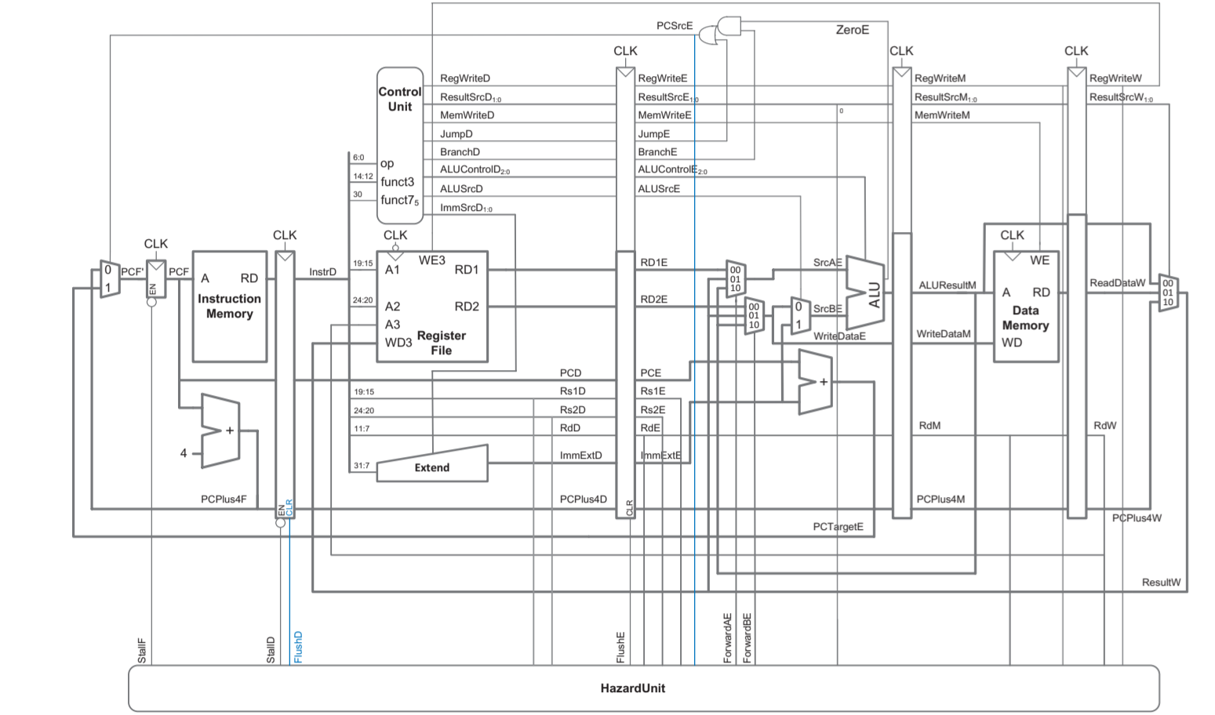
Pipelined
Control Hazards :
Notes:
Motorola 68000 Family

Slide 35
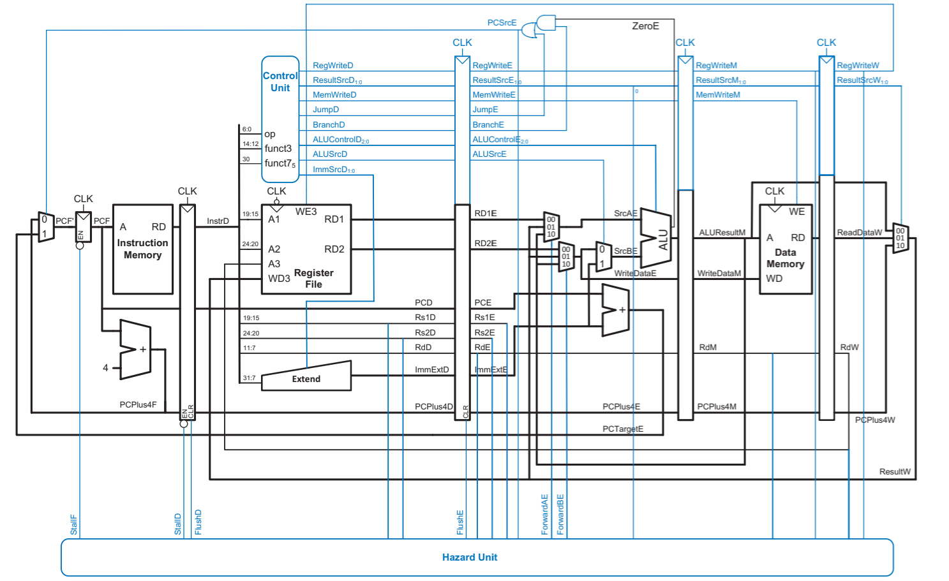
Pipelined
RISC-V Pipelined Processor with Hazard Unit :
Notes:
Motorola 68000 Family

Slide 36
Pipelined
RISC-V Pipelined Processor with Hazard Unit :
Notes:
Motorola 68000 Family

Slide 37
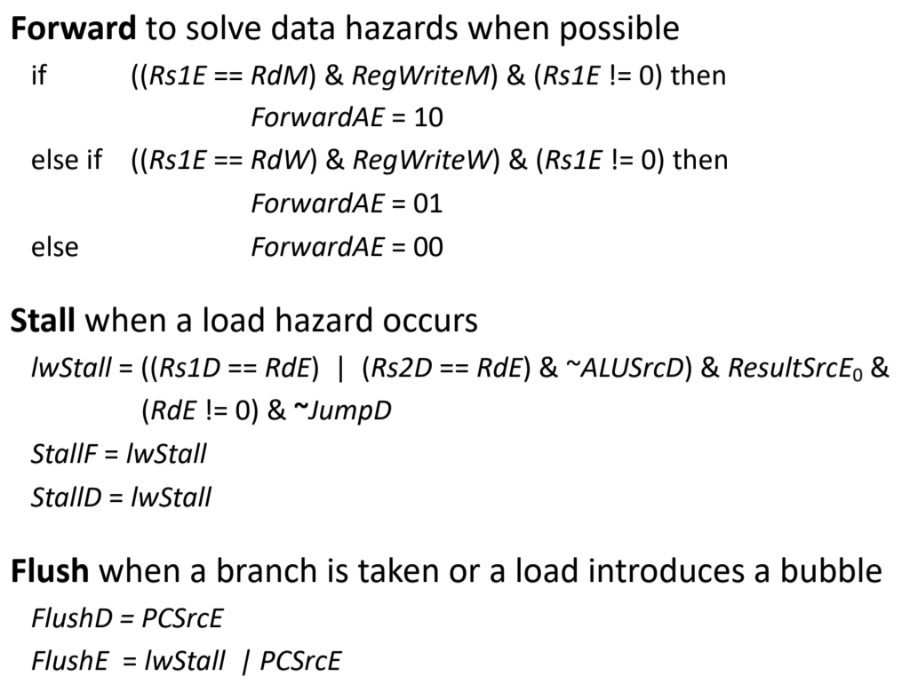
Pipelined
Hazard Unit :
Notes:
Motorola 68000 Family

Slide 38
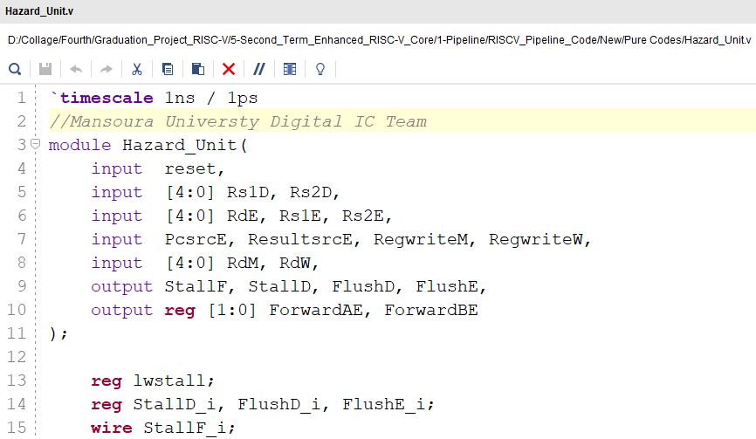
Pipelined
Hazard Unit :
Notes:
Motorola 68000 Family

Slide 39
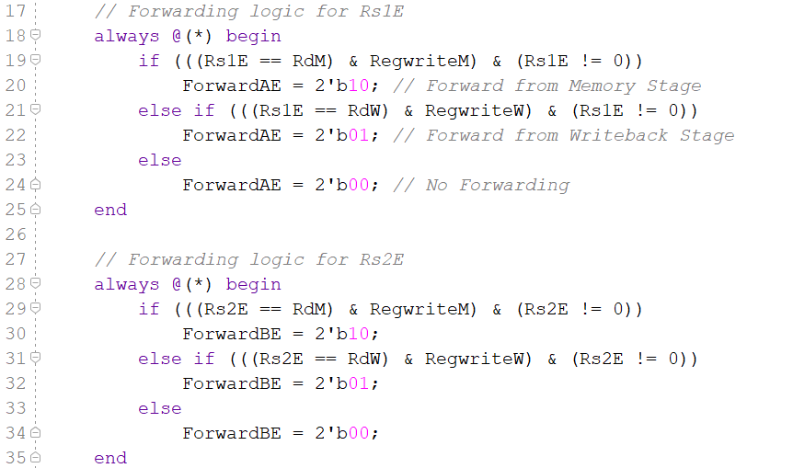
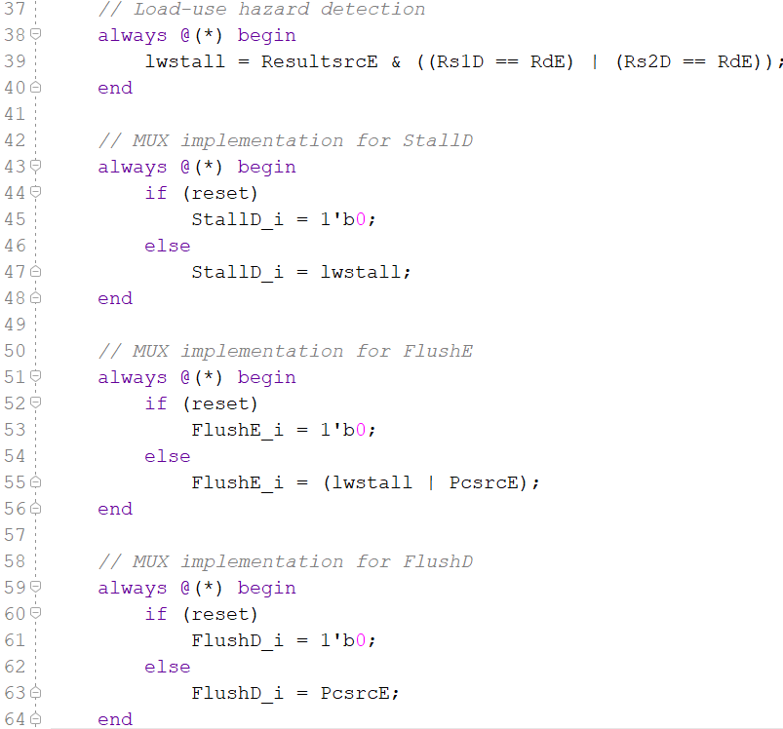
Pipelined
Hazard Unit :
Notes:
Motorola 68000 Family

Slide 40
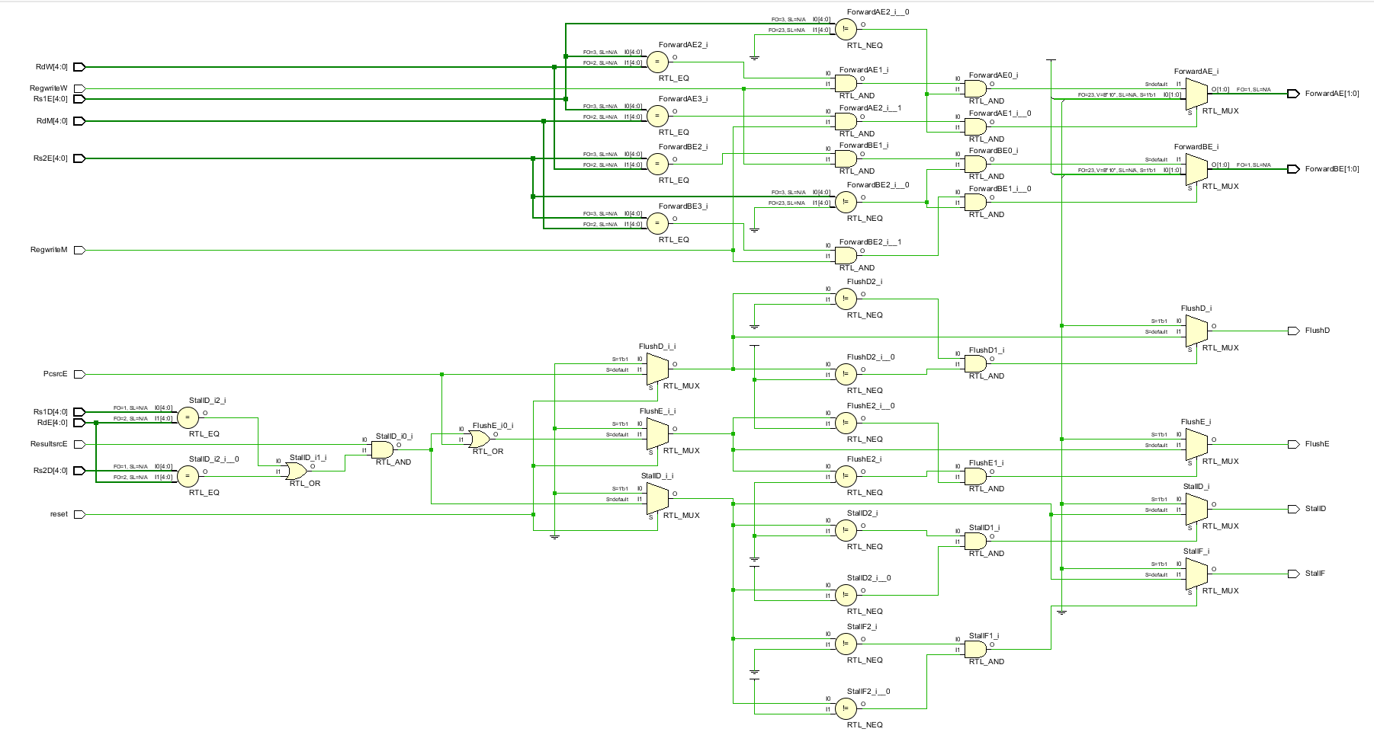
Notes:
Motorola 68000 Family

Slide 41
Pipelined
Pipelined Integration :
Notes:
Motorola 68000 Family

Slide 42
Pipelined
Pipelined Integration :
Notes:
Motorola 68000 Family

Slide 43
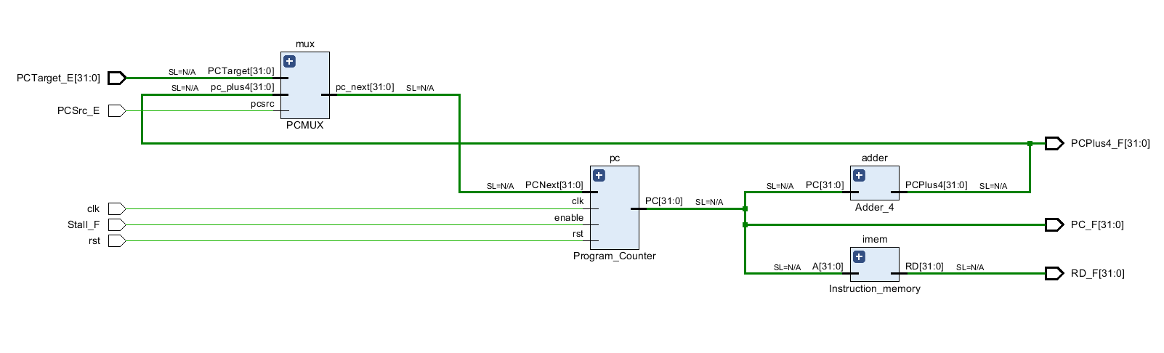
Pipelined
Pipelined Integration FS:
Notes:
Motorola 68000 Family

Slide 44
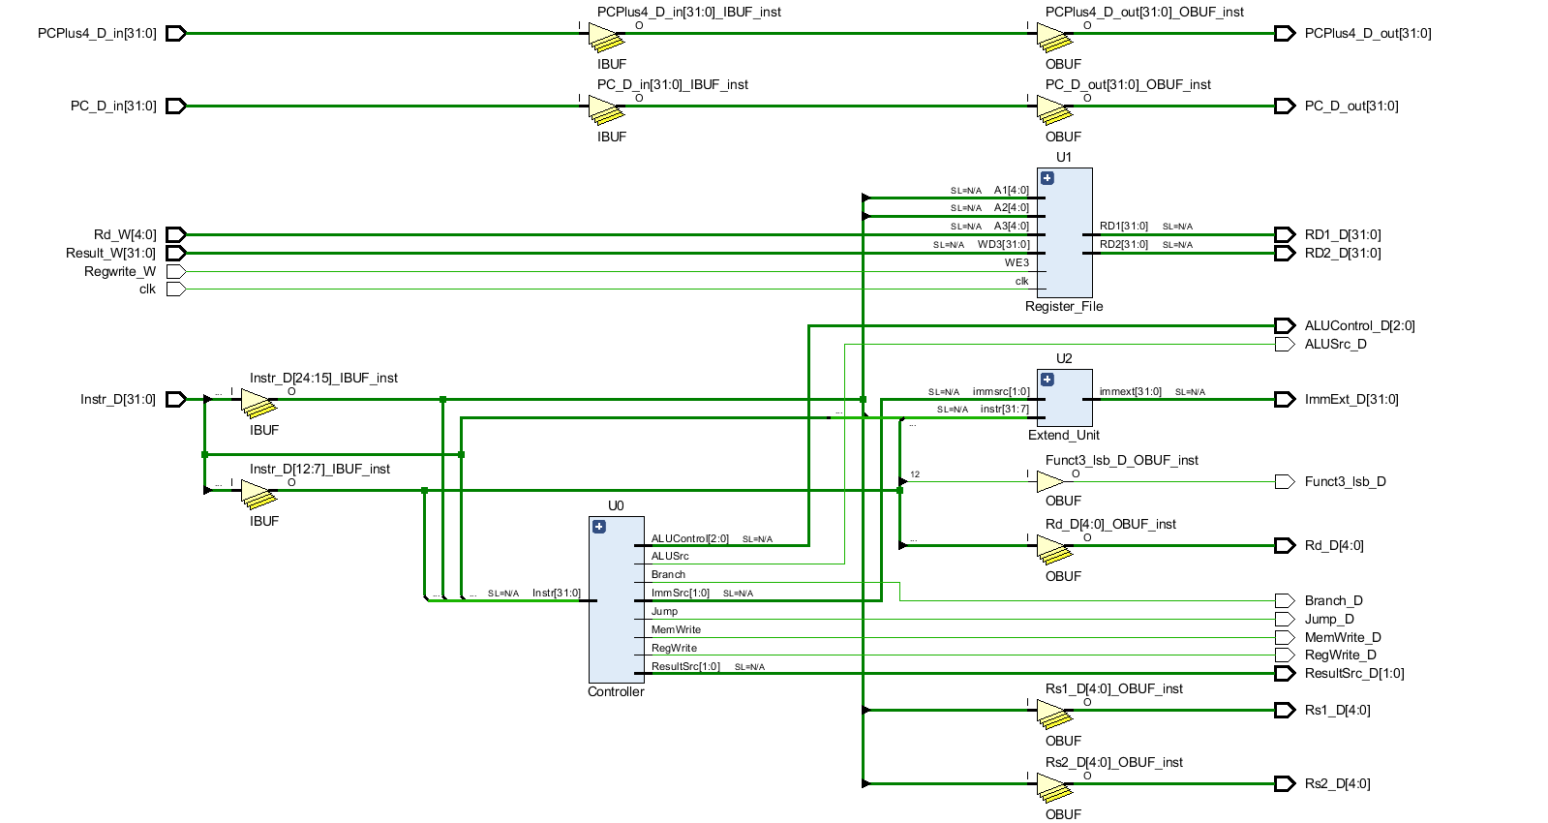
Pipelined
Pipelined Integration DS:
Notes:
Motorola 68000 Family

Slide 45
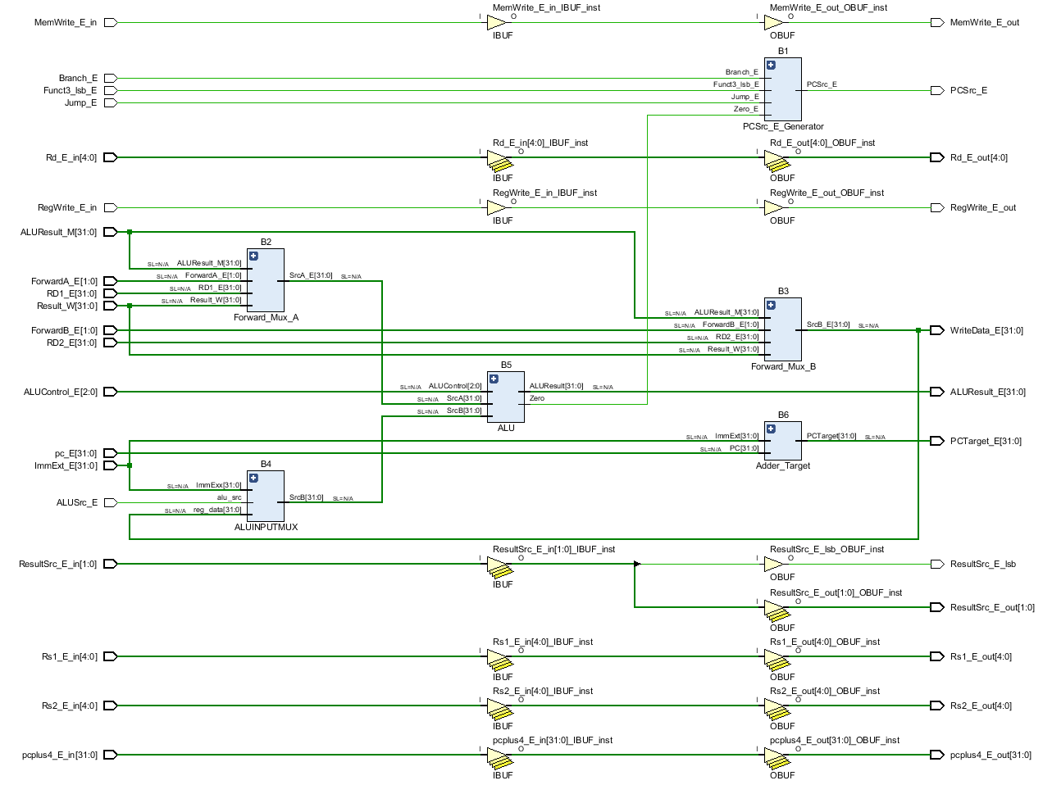
Pipelined
Pipelined Integration ES:
Notes:
Motorola 68000 Family

Slide 46
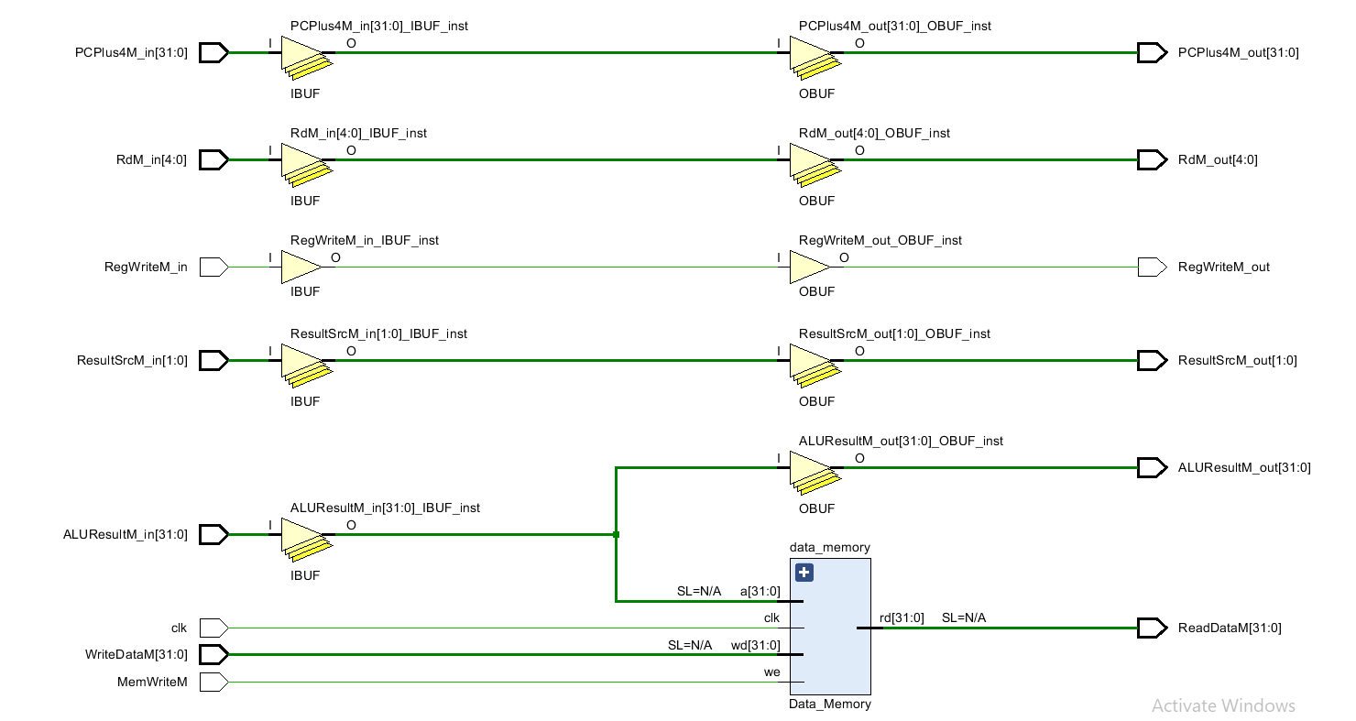
Pipelined
Pipelined Integration MS:
Notes:
Motorola 68000 Family

Slide 47

Pipelined
Pipelined Integration WBS:
Notes:
Motorola 68000 Family

Slide 48

Pipelined
Pipelined Integration SI:
Notes:
Motorola 68000 Family

Slide 49

Pipelined
Pipelined Integration SI:
Notes:
Motorola 68000 Family

Slide 50

Pipelined
RISC-V Pipelined Integration :
Notes:
Motorola 68000 Family

Slide 51

Pipelined
Testing :

Slide 52



Pipelined
Tool :

Slide 53


Pipelined
Test 1 :

Slide 54

Pipelined
Test 1 :

Slide 55

Pipelined
Test 1 :

Slide 56

Pipelined
Simulation For Test 1 :

Slide 57

Pipelined
Simulation For Test 1 :
X2 | 5 , 7 , 25
X3 | 12 , 68
X4 | 7 , 0 , 1
X5 | 4, 11
X7 | 3 , 12 , 7
X9 | 18
25 | 25
24 | 7

Slide 58


Pipelined
Test 2 :

Slide 59


Pipelined
Test 2 :
X2 | 5 , 6 , 23
X3 | 12 , 100
X4 | 7 , 0
X5 | 4, 11
X6 | 384
X7 | 3 , 10 , 11 , 6
X8 | 0
X9 | 3 , 17
X10 | 9
X11 | 11
33 | 23
24 | 6

Slide 60

Pipelined
Results :

Slide 61


Pipelined
Results :
The cycle time of the Pipelined processor is :
Processor frequancy will be :

Slide 62

02
03
Advanced Arithmetic

Slide 63


Advanced Arithmetic
Importance :
Support complex mathematical functions.
Essential for scientific and engineering applications.
Enable accurate and efficient floating-point calculations.
Crucial for graphics, AI, and data analysis.
Enhance the processor’s capabilities.
Notes:
Motorola 68000 Family

Slide 64

Advanced Arithmetic
Addition and subtraction :
Addition is the most essential arithmetic operation as all other operations can be built using it.
Notes:
Motorola 68000 Family

Slide 65

Advanced Arithmetic
Addition and subtraction :
Addition is the most essential arithmetic operation as all other operations can be built using it.
Notes:
Motorola 68000 Family

Slide 66

Advanced Arithmetic
Addition and subtraction :
A subtraction circuit can be easily built from an adder by using 2's complement.
This way, subtraction becomes: A − B = A + (−B).
Notes:
Motorola 68000 Family

Slide 67

Advanced Arithmetic
Multiplier :
Multiplication is a basic yet powerful arithmetic operation.
Multiplication is essential in digital signal processing and graphics.
It is implemented using specialized circuits for high speed.
Multiplication is built on repeated addition but optimized for performance.
Notes:
Motorola 68000 Family

Slide 68

Advanced Arithmetic
Multiplier :
Notes:
Motorola 68000 Family

Slide 69

Advanced Arithmetic
Multiplier :
Notes:
Motorola 68000 Family

Slide 70

Advanced Arithmetic
Optimized Multiplier :
Notes:
Motorola 68000 Family

Slide 71

Advanced Arithmetic
Optimized Multiplier :
Notes:
Motorola 68000 Family

Slide 72

Advanced Arithmetic
Faster Multiplier :
Faster multipliers use parallel adders organized in a tree structure, reducing multiplication time from 64 steps to just log₂(64) = 6 steps.
Notes:
Motorola 68000 Family

Slide 73

Advanced Arithmetic
Multiplier Code :
Notes:
Motorola 68000 Family

Slide 74

Advanced Arithmetic
Multiplier Code :
Notes:
Motorola 68000 Family

Slide 75



Advanced Arithmetic
Multiplier Design:
Notes:
Motorola 68000 Family

Slide 76

Advanced Arithmetic
Multiplier Testing:
Notes:
Motorola 68000 Family

Slide 77
Advanced Arithmetic
Signed Multiplier :
To multiply signed numbers, we first convert both operands to positive.
We perform the multiplication normally, ignoring signs during calculation.
After completing the operation, we negate the result only if the original signs were different.
The same algorithm for unsigned multiplication can be reused by handling
sign extension during shifting.
Final result is stored in the lower 64 bits (doubleword) of the product.
Notes:
Motorola 68000 Family

Slide 78

Advanced Arithmetic
Divisor :
Division is a fundamental arithmetic operation used to split or compare values.
It is more complex and slower than addition, subtraction, and multiplication.
Division is essential in scaling, normalization, and calculating averages.
Division can be implemented using repeated subtraction and shifts.
Notes:
Motorola 68000 Family

Slide 79

Advanced Arithmetic
Divisor :
Notes:
Motorola 68000 Family

Slide 80

Advanced Arithmetic
Divisor :
Notes:
Motorola 68000 Family

Slide 81

Advanced Arithmetic
Divisor :
Notes:
Motorola 68000 Family

Slide 82

Advanced Arithmetic
Divisor :
Notes:
Motorola 68000 Family

Slide 83

Advanced Arithmetic
Divisor :
Notes:
Motorola 68000 Family

Slide 84


Advanced Arithmetic
Divisor Code:
Notes:
Motorola 68000 Family

Slide 85


Advanced Arithmetic
Divisor Design:
Notes:
Motorola 68000 Family

Slide 86

Advanced Arithmetic
Divisor Testing:
Notes:
Motorola 68000 Family

Slide 87

Advanced Arithmetic
Floating Point :
Used when operands can be positive or negative.
Requires special handling for sign bits.
Common method: convert inputs to positive, then adjust sign at the end.
Same multiplication logic as unsigned, with minor changes.
Sign extension is needed during shifting steps.
Final product is negated only if the input signs are different.
Efficient reuse of unsigned multiplier hardware.
We use IEEE 754 Floating-Point Standard.
Notes:
Motorola 68000 Family

Slide 88

Advanced Arithmetic
Floating Point Addition:
Involves aligning the exponents before adding the numbers.
Number with the smaller exponent is shifted right .
Once aligned, the mantissas (fractions) are added.
May involve rounding to fit the result within limited precision.
Used heavily in scientific, engineering, and graphics.
More complex than integer addition due to alignment.
Notes:
Motorola 68000 Family

Slide 89


Advanced Arithmetic
Floating Point Addition Examples:
Notes:
Motorola 68000 Family

Slide 90

Advanced Arithmetic
Floating Point Addition Code:
Notes:
Motorola 68000 Family

Slide 91

Advanced Arithmetic
Floating Point Addition Code:
Notes:
Motorola 68000 Family

Slide 92

Advanced Arithmetic
Floating Point Addition Design:
Notes:
Motorola 68000 Family

Slide 93

Advanced Arithmetic
Floating Point Addition Testing:
Notes:
Motorola 68000 Family

Slide 94

Advanced Arithmetic
Floating Point Addition Testing:
Notes:
Motorola 68000 Family

Slide 95

Advanced Arithmetic
Floating Point Multiplier :
Notes:
Motorola 68000 Family

Slide 96

Advanced Arithmetic
Floating Point Multiplier :
Notes:
Motorola 68000 Family

Slide 97


Advanced Arithmetic
Floating point Multiplier :
Notes:
Motorola 68000 Family

Slide 98

Advanced Arithmetic
Floating point Multiplier :
Notes:
Motorola 68000 Family

Slide 99

Advanced Arithmetic
Floating point Multiplier :
Notes:
Motorola 68000 Family

Slide 100

Advanced Arithmetic
Floating point Multiplier :
Notes:
Motorola 68000 Family

Slide 101

3
2
1
04
Communication Extensions
GPIO
UART
AMPA APB

Slide 102
1
2
3
AMPA APB
UART
GPIO

Slide 103

AMPA APB protocol
Characteristics :
APB (Advanced Peripheral Bus) is a part of the AMBA protocol family
Developed by ARM to connect low-speed peripherals.
Designed for low power and simple interface needs.
Ideal for power-sensitive applications
Used mainly with devices like UART, GPIO, Timers, etc.
Reduces design complexity in SoC systems.
Notes:
Motorola 68000 Family

Slide 104

AMPA APB protocol
APB Signals :
Notes:
Motorola 68000 Family

Slide 105


AMPA APB protocol
APB Signals :
Notes:
Motorola 68000 Family

Slide 106

AMPA APB protocol
APB Design :
Notes:
Motorola 68000 Family

Slide 107


AMPA APB protocol
APB Design :
Notes:
Motorola 68000 Family

Slide 108


AMPA APB protocol
APB Design :
Notes:
Motorola 68000 Family

Slide 109

AMPA APB protocol
APB Design :
Notes:
Motorola 68000 Family

Slide 110

AMPA APB protocol
APB Testing (Results of Master Write Operation):
Notes:
Motorola 68000 Family

Slide 111

AMPA APB protocol
APB Testing (Results of Master Read Operations):
Notes:
Motorola 68000 Family

Slide 112

UART protocol
Characteristics :
A serial asynchronous communication protocol used for data transfer.
Supports point-to-point communication — no addressing needed.
Requires only two lines: TX (Transmit) and RX (Receive).
Commonly found in microcontrollers, FPGAs, sensors, and embedded systems.
Still used in over 80% of embedded systems as a basic communication interface
Notes:
Motorola 68000 Family

Slide 113

UART protocol
Characteristics :
Notes:
Motorola 68000 Family

Slide 114

UART protocol
Block Diagram :
Notes:
Motorola 68000 Family

Slide 115
UART protocol
Block Diagram :
Notes:
Motorola 68000 Family

Slide 116














UART protocol
Baud rate generator (Timer) :
Notes:
Motorola 68000 Family

Slide 117


UART protocol
Baud rate generator (Timer) :
Notes:
Motorola 68000 Family

Slide 118

UART protocol
Baud rate generator (Timer) :
Notes:
Motorola 68000 Family

Slide 119










UART protocol
FIFO buffer :
Notes:
Motorola 68000 Family

Slide 120


UART protocol
FIFO buffer :
Notes:
Motorola 68000 Family

Slide 121

UART protocol
FIFO buffer :
Notes:
Motorola 68000 Family

Slide 122

UART protocol
FIFO buffer :
Notes:
Motorola 68000 Family

Slide 123

UART protocol
FIFO buffer :
Notes:
Motorola 68000 Family

Slide 124







UART protocol
UART TX :
Notes:
Motorola 68000 Family

Slide 125

UART protocol
UART TX :
Notes:
Motorola 68000 Family

Slide 126


UART protocol
UART TX :
Notes:
Motorola 68000 Family

Slide 127


UART protocol
UART TX :
Notes:
Motorola 68000 Family

Slide 128

UART protocol
UART TX :
Notes:
Motorola 68000 Family

Slide 129






UART protocol
UART RX :
Notes:
Motorola 68000 Family

Slide 130

UART protocol
UART RX :
Notes:
Motorola 68000 Family

Slide 131


UART protocol
UART RX :
Notes:
Motorola 68000 Family

Slide 132

UART protocol
UART RX :
Notes:
Motorola 68000 Family

Slide 133

UART protocol
UART integration:
Notes:
Motorola 68000 Family

Slide 134

GPIO
Characteristics :
Common in FPGAs, microcontrollers, SoCs, and dev boards
Can be configured as either input (read) or output (write)
A basic digital pin used for input or output operations
Found in nearly 100% of embedded systems and development platforms.
Notes:
Motorola 68000 Family

Slide 135



GPIO
Code:
Notes:
Motorola 68000 Family

Slide 136

GPIO
Design:
Notes:
Motorola 68000 Family

Slide 137

GPIO
Testing:
Notes:
Motorola 68000 Family

Slide 138

Protocol integration with RISC-V
Integration :
Notes:
Motorola 68000 Family

Slide 139

Protocol integration with RISC-V
APB with Peripherals :
Notes:
Motorola 68000 Family

Slide 140

Protocol integration with RISC-V
RISC-V with communication extensions :
Notes:
Motorola 68000 Family

Slide 141

Protocol integration with RISC-V
Testing :
Notes:
Motorola 68000 Family

Slide 142

02
05
Conclusion

Slide 143
Conclusion
Successfully designed and implemented a RISC-V based processor core.
Integrated essential peripherals such as UART and GPIO using APB protocol.
Achieved correct functionality through simulation and verification.
Followed a modular and scalable design approach.
hands-on experience in SoC design, hardware description languages, and bus protocols.
Ready for real-world applications and further development.
Future Work
Perform FPGA synthesis and real-time testing on hardware board.
Optimize power and area usage for ASIC implementation.
Explore cache implementation and memory hierarchy for future scalability.
Notes:
Motorola 68000 Family

Slide 144


